Slide 1
About Me
Ritesh Singh
Sun Certified java Professional
Oracle Certified Database Administrator
Certified Ethical Hacker
Certified EC-Council Instructor (CEI)

Slide 2
Course Overview
Introduction to SQL LIMIT clause

Slide 3
Introduction to SQL LIMIT clause
To retrieve a portion of rows returned by a query, you use the LIMIT and OFFSET clauses. The following illustrates the syntax of these clauses:
SELECT
column_list
FROM
table1
ORDER BY column_list
LIMIT row_count OFFSET offset;

Slide 4
In this syntax:
The row_count determines the number of rows that will be returned.
The OFFSET clause skips the offset rows before beginning to return the rows. The OFFSET clause is optional so you can skip it. If you use both LIMIT and OFFSET clauses the OFFSET skips offset rows first before the LIMIT constrains the number of rows.
When you use the LIMIT clause, it is important to use an ORDER BY clause to make sure that the rows in the returned are in a specified order.

Slide 5
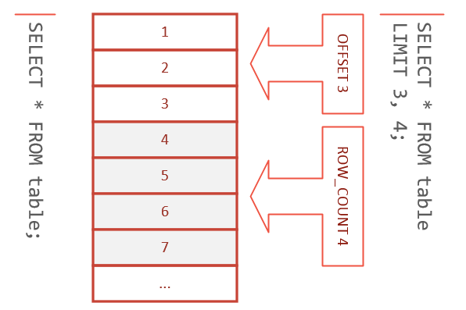
Not all database systems support the LIMIT clause, therefore, the LIMIT clause is available only in some database systems only such as MySQL, PostgreSQL, SQLite, Sybase SQL Anywhere, and HSQLDB.

Slide 6
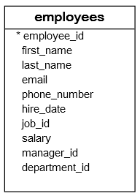
SQL LIMIT clause examples
We will use the employees table in the sample database to demonstrate the LIMIT clause
The following statement returns all rows in the employees table sorted by the first_name column.

Slide 7
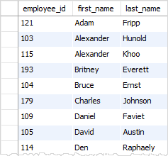
SELECT employee_id, first_name, last_name FROM employees ORDER BY first_name;
To return just top 5 rows, you use the LIMIT clause as the following statement.

Slide 8
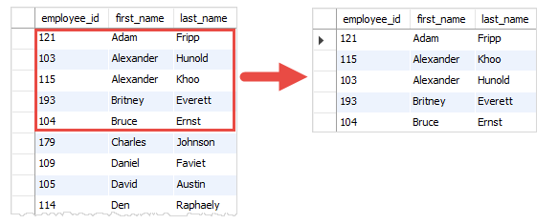
SELECT employee_id, first_name, last_name FROM employees ORDER BY first_name LIMIT 5;

Slide 9
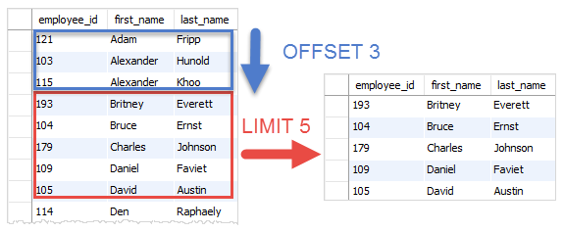
To skip two rows and get the next five rows, you use both LIMIT and OFFSET clauses as shown in the following statement.
SELECT employee_id, first_name, last_name FROM employees ORDER BY first_name LIMIT 5 OFFSET 3;

Slide 10
If you are using MySQL, you can use the shorter form of the LIMIT OFFSET clauses.
SELECT
employee_id, first_name, last_name
FROM
employees
ORDER BY first_name
LIMIT 3 , 5;

Slide 11
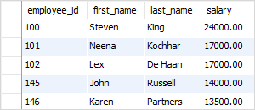
Using SQL LIMIT to get the top N rows with the highest or lowest value
You can use the LIMIT clause to get the top N rows with the highest or lowest value. For example, the following statement gets the top five employees with the highest salaries.
SELECT
employee_id, first_name, last_name, salary
FROM
employees
ORDER BY salary DESC
LIMIT 5;

Slide 12
First, the ORDER BY clause sorts the employees by salary in the descending order and then the LIMIT clause restricts five rows returned from the query.

Slide 13
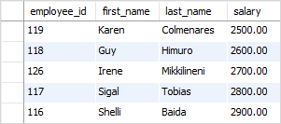
To get the top five employees with the lowest salary, you sort the employees by salary in the ascending order instead.

Slide 14
Getting the rows with the N^{th} highest value
Suppose you have to get employees whose has 2nd highest salary in the company. To do so, you use the LIMIT OFFSET clauses as follows.
SELECT
employee_id, first_name, last_name, salary
FROM
employees
ORDER BY salary DESC
LIMIT 1 OFFSET 1;

Slide 15

The ORDER BY clause sorts the employees by salary in descending order. And the LIMIT 1 OFFSET 1 clause gets the second row from the result set.
This query works with the assumption that every employee has a different salary. It will fail if there are two employees who have the same highest salary. In addition, in case you have two or more employees who have the same 2nd highest salary, the query just returns the first one.
To fix this issue, you can get the second highest salary first using the following statement.
SELECT DISTINCT
salary
FROM
employees
ORDER BY salary DESC
LIMIT 1 , 1;

Slide 16

And pass the result to another query:
SELECT
employee_id, first_name, last_name, salary
FROM
employees
WHERE
salary = 17000;

Slide 17
If you know subquery, you can combine both queries into a single query as follows:
SELECT
employee_id, first_name, last_name, salary
FROM
employees
WHERE
salary = (SELECT DISTINCT
salary
FROM
employees
ORDER BY salary DESC
LIMIT 1 , 1);

Slide 18
Summary
In this tutorial, we have introduced you to the SQL LIMIT and OFFSET clauses that allow you to constrain the number of rows returned by a query.

Slide 19
Thank You
Please Subscribe My Channel
https://www.youtube.com/channel/UCYW3PWPOPn3qgxxjhUbXXXg?view_as=subscriber

